Slide 1
Introduction to Communication Networks – 67594
Prof. Yossi Gilad
Some of the slides were taken from Prof. Scott Shenker, UC Berkeley,
others from Prof. Michael Schapira, HUJI

Slide 2
Interconnecting IP Subnets

Slide 3

Interconnecting IP Subnets
223.1.1.2
223.1.1.1
223.1.1.4
223.1.1.3
223.1.9.2
223.1.7.0
223.1.9.1
223.1.7.1
223.1.8.1
223.1.8.0
223.1.2.6
223.1.3.27
223.1.2.1
223.1.2.2
223.1.3.1
223.1.3.2

Slide 4
Two Key Characteristics of a Network
Topology
Physical interconnection structure of the network
Routing algorithm
restricts the set of paths that messages/data can follow

Slide 5
Topology
How the components are connected.
Important properties
Diameter: maximum distance between any two nodes in the network (hop count, or # of links).
Nodal degree: how many links connect to a node.
Bisection bandwidth: The lowest bandwidth between half the nodes and the other half of the nodes, across all such partitions.
A good topology: small diameter? small nodal degree? large bisection bandwidth?

Slide 6
HOW GOOD IS THIS NETWORK?
.
.
.
.
.
.

Slide 7
BISECTION BANDWIDTH
.
.
.
.
.
.

Slide 8
BISECTION BANDWIDTH
.
.
.
.
.
.

Slide 9
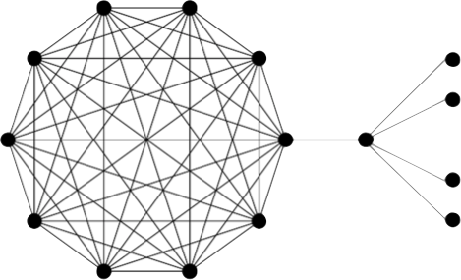

BISECTION BANDWIDTH
Is bisection bandwidth a good enough measure?

Slide 10

Expansion of a Graph
Why not examine every partition into two sets?
S
V\S

Slide 11
Expansion of a Graph
This is called the “edge expansion” of a graph
Expanders are graphs with “high” edge expansion
Example: A random d-regular graph has edge expansion ~d/2 with high probability (the best possible)

Slide 12
Explicit vs. Non-explicit Topologies
Explicit constructions
Nodes are connected with some kind of patterns.
The graph has a structure.
Nodes are identified by coordinates.
Routing can usually pre-determined by the coordinates of the nodes.
Non-explicit constructions
Nodes are connected arbitrarily.
The graph does not have a structure
More extensible in comparison to regular topology.
Often use variations of shortest path routing

Slide 13
Linear Arrays and Rings
linear array
ring (torus)
Diameter = ? nodal degree = ? Bisection bandwidth = ?

Slide 14
Describing Linear Array and Ring
Array: nodes are numbered from 0, 1, …, N-1
Node i is connected to node i+1, for i < N-1
Ring: nodes are numbered from 0, 1, …, N-1
Node i is connected to node (i+1) mod N, for all i

Slide 15
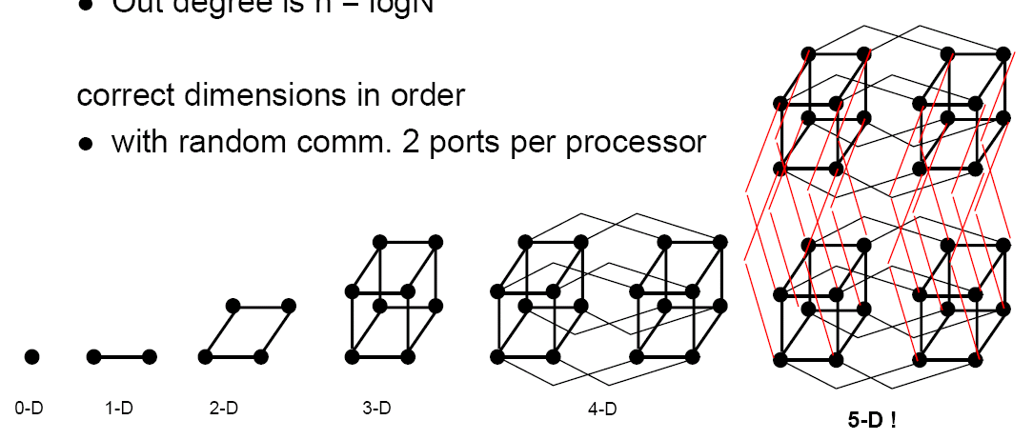
Hypercubes
Binary n-cubes. # of nodes = N = 2^{n}
Each node is described by its binary representation.
there is a link between two nodes with hamming distance 1
Nodal degree = ? Diameter=? Bisection bandwidth = ?

Slide 16
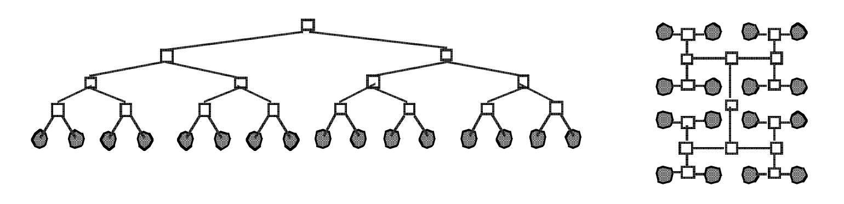
Trees
Fixed degree, log(N) diameter, O(1) bisection bandwidth
Routing: up to the common ancestor then go down

Slide 17
Routing
We focus on routing within a single organization
intradomain routing
We will discuss inter-organization routing later on
A network of routers
links represent IP subnets

Slide 18
Interplay between routing, forwarding
routing algorithm
local forwarding table
header value
output link
0100
0101
0111
1001
3
2
2
1
value in arriving
packet’s header
0111
1
3
2

Slide 19
Shortest-Path Routing With “Static” Link Weights
Compute shortest paths to IP subnets based on link weights
link weights configured by network operator (to be revisited)
... to determine the “next hop” router to every IP subnet
2
3
1
1
3
2
1
5
4
3

Slide 20
Two Routing Schemes
Link-State Routing
routers flood information to learn topology
each router then applies Dijkstra’s algorithm to compute shortest paths
Distance Vector Routing
iterative process
Bellman-Ford algorithm

Slide 21
Routing Algorithm Classification
Global or decentralized information?
Global:
all routers have complete topology, link cost info
“link state” algorithms
Decentralized:
router knows only physically-connected neighbors, link costs to neighbors
iterative process of computation and exchange of info with neighbors
“distance vector” algorithms

Slide 22
A Link-State Routing Algorithm
Dijkstra’s algorithm
net topology, link costs known to all nodes
accomplished via “link state broadcast”
all nodes have same info
computes least cost paths from one node (‘source”) to all other nodes
gives forwarding table for that node
iterative: after k iterations, know least cost path to k dest.’s
Notation:
c(x,y): link cost from node x to y; = ∞ if not direct neighbors
D(v): current value of cost of path from source to dest. v
p(v): predecessor node along path from source to v
V': set of nodes whose least cost path definitively known

Slide 23
Dijsktra’s Algorithm
1 Initialization:
2 V' = {u}
3 for all nodes v
4 if v adjacent to u
5 then D(v) = c(u,v)
6 else D(v) = ∞
7
8 Loop
9 find w not in V' such that D(w) is a minimum
10 add w to V'
11 update D(v) for all v adjacent to w and not in V' :
12 D(v) = min( D(v), D(w) + c(w,v) )
13 /* new cost to v is either old cost to v or known
14 shortest path cost to w plus cost from w to v */
15 until all nodes in V'

Slide 24
Dijkstra’s algorithm: example
Step
0
1
2
3
4
5
D(v),p(v)
2,u
2,u
2,u
D(w),p(w)
5,u
4,x
3,y
3,y
D(x),p(x)
1,u
D(y),p(y)
∞
2,x
V’
{u}
{u,x}
{u,x,y}
{u,x,y,v}
{u,x,y,v,w}
{u,x,y,v,w,z}
D(z),p(z)
∞
∞
4,y
4,y
4,y
5
v
3
w
2
5
u
2
1
z
3
1
2
x
y
1

Slide 25
Dijkstra’s algorithm, discussion
Algorithm complexity: n nodes
Naïve implementation n(n+1)/2 comparisons: O(n²)
more efficient implementations possible: O(nlogn)
Oscillations possible if link weights are set dynamically:
e.g., link cost = amount of carried traffic

Slide 26
Dijkstra’s algorithm, discussion
Algorithm complexity: n nodes
Naïve implementation n(n+1)/2 comparisons: O(n²)
more efficient implementations possible: O(nlogn)
Oscillations possible if link weights are set dynamically:
e.g., link cost = amount of carried traffic
1
A
A
A
A
1+ε
2+ε
0
0
2+ε
2+ε
0
D
0
0
B
D
B
D
B
D
B
1
1+ε
0
0
1
ε
1+ε
0
C
0
0
1
0
ε
C
1+ε
1
C
C
1
ε
… recompute
routing
… recompute
… recompute
initially

Slide 27
Distance Vector Algorithm
Bellman-Ford Equation (dynamic programming)
Define
d_{x}(y) := cost of least-cost path from x to y
Then
d_{x}(y) = min {c(x,v) + d_{v}(y) }
where min is taken over all neighbors v of x
v

Slide 28
Bellman-Ford example
5
Clearly, d_{v}(z) = 5, d_{x}(z) = 3, d_{w}(z) = 3
v
3
w
2
5
u
z
B-F equation says:
2
1
3
1
2
d_{u}(z) = min { c(u,v) + d_{v}(z),
c(u,x) + d_{x}(z),
c(u,w) + d_{w}(z) }
= min {2 + 5,
1 + 3,
5 + 3} = 4
x
y
1
Node that achieves minimum is next
hop in shortest path ➜ forwarding table

Slide 29
Distance Vector Algorithm
D_{x}(y) = estimate of least cost from x to y
Node x knows cost to each neighbor v: c(x,v)
Node x maintains distance vector D_{x} = [D_{x}(y): y є V ]
Node x also maintains its neighbors’ distance vectors
For each neighbor v, x maintains D_{v} = [D_{v}(y): y є V ]

Slide 30
Distance Vector Algorithm
Basic idea:
From time-to-time, each node sends its own distance vector estimate to neighbors
Asynchronous
When a node x receives new DV estimate from neighbor, it updates its own DV using B-F equation:
D_{x}(y) ← min_{v}{c(x,v) + D_{v}(y)} for each node y ∊ N
D_{x}(y) converges to the actual least cost d_{x}(y)

Slide 31
Distance Vector Algorithm
Iterative, asynchronous: each local iteration caused by:
local link cost change
DV update message from neighbor
Distributed:
each node notifies neighbors only when its DV changes
neighbors then notify their neighbors if necessary
Each node:
wait for (change in local link cost or msg from neighbor)
recompute estimates
if DV to any dest has changed, notify neighbors

Slide 32
D_{x}(y) = min{c(x,y) + D_{y}(y), c(x,z) + D_{z}(y)} = min{2+0 , 7+1} = 2
D_{x}(z) = min{c(x,y) + D_{y}(z), c(x,z) + D_{z}(z)}
= min{2+1 , 7+0} = 3
node x table
cost to
cost to
x y z
x y z
x
0 2 7
x
0
2
3
from
y
∞
∞
∞
from
y
2 0 1
z
∞
∞
∞
z
7 1 0
node y table
cost to
x y z
y
2
1
x
∞
∞
z
∞
2 0 1
x
from
y
7
z
∞
∞
∞
node z table
cost to
x y z
x
∞ ∞ ∞
from
y
∞
∞
∞
z
7
1
0
time

Slide 33
D_{x}(y) = min{c(x,y) + D_{y}(y), c(x,z) + D_{z}(y)} = min{2+0 , 7+1} = 2
D_{x}(z) = min{c(x,y) + D_{y}(z), c(x,z) + D_{z}(z)}
= min{2+1 , 7+0} = 3
node x table
cost to
cost to
cost to
x y z
x y z
x y z
x
0 2 7
x
0 2 3
x
0 2 3
from
y
∞
∞
∞
from
y
2 0 1
from
y
2 0 1
z
∞
∞
∞
z
7 1 0
z
3 1 0
node y table
cost to
cost to
cost to
x y z
x y z
x y z
y
2
1
x
∞
∞
x
0 2 7
z
∞
2 0 1
x
0 2 3
x
from
y
from
y
2 0 1
from
y
7
2 0 1
z
∞
∞
∞
z
7 1 0
z
3 1 0
node z table
cost to
cost to
cost to
x y z
x y z
x y z
x
∞ ∞ ∞
x
0 2 7
x
0 2 3
from
y
from
y
2 0 1
from
y
2 0 1
∞
∞
∞
z
z
3 1 0
z
3 1 0
7
1
0
time

Slide 34
Distance Vector: Count-to-Infinity
Link cost changes:
node detects local link cost change
updates routing info, recalculates distance vector
if DV changes, notify neighbors
1
y
4
1
x
z
50
At time t₀, y detects the link-cost change, updates its DV,
and informs its neighbors.
“good
news
travels
fast”
At time t₁, z receives the update from y and updates its table.
It computes a new least cost to x and sends its neighbors its DV.
At time t₂, y receives z’s update and updates its distance table.
y’s least costs do not change and hence y does not send any
message to z.

Slide 35
Distance Vector: Count-to-Infinity
Link cost changes:
good news travels fast
bad news travels slow - “count to infinity” problem!
44 iterations before algorithm stabilizes
60
y
4
1
x
z
50
Distance Vectors:
Cost Vectors:
Routing Tables:
cost to
C(x,y)=4
C(x,z)=50
C(y,z)=1
60
At x: to y on (x->y) to z on (x->y)
At y: to x on (y->x)
to z on (y->z)
At z: to x on (z->y)
to y on (z->y)
x y z
x
0 4 5
from
y
4
0
1
z
5
1
0

Slide 36
Distance Vectors:
Cost Vectors:
Routing Tables:
cost to
C(x,y)=4
C(x,z)=50
C(y,z)=1
60
At x: to y on (x->y) to z on (x->y)
At y: to x on (y->x)
to z on (y->z)
At z: to x on (z->y)
to y on (z->y)
x y z
x
0 4 5
60
from
y
4
0
1
y
z
4
1
5
1
0
x
z
50
D_{x}(y) = min{c(x,y) + D_{y}(y), c(x,z) + D_{z}(y)} = min{60+0 , 50+1} = 51
D_{x}(z) = min{c(x,y) + D_{y}(z), c(x,z) + D_{z}(z)} = min{60+1 , 50+0} = 50
D_{y}(x) = min{c(y,x) + D_{x}(x), c(y,z) + D_{z}(x)} = min{60+0 , 1+5} = 6
D_{y}(z) = min{c(y,x) + D_{x}(z), c(y,z) + D_{z}(z)} = min{60+5 , 1+0} = 1
D_{z}(x) = min{c(z,x) + D_{x}(x), c(z,y) + D_{y}(x)} = min{50+0 , 1+4} = 5
D_{z}(y) = min{c(z,y) + D_{y}(y), c(z,x) + D_{x}(y)} = min{1+0 , 50+4} = 1
cost to
x y z
x
0 51 50
from
y
6
0
1
z
5
1
0
Infinite loop
At x: to y on (x->z) to z on (x->z)
At y: to x on (y->z)
to z on (y->z)
At z: to x on (z->y)
to y on (z->y)

Slide 37
Distance Vectors:
Cost Vectors:
Routing Tables:
cost to
C(x,y)=60
C(x,z)=50
C(y,z)=1
At x: to y on (x->z) to z on (x->z)
At y: to x on (y->z)
to z on (y->z)
At z: to x on (z->y)
to y on (z->y)
x y z
x
0 51 50
from
y
6
0
1
y
z
60
1
5
1
0
x
z
50
D_{x}(y) = min{c(x,y) + D_{y}(y), c(x,z) + D_{z}(y)} = min{60+0 , 50+1} = 51
D_{x}(z) = min{c(x,y) + D_{y}(z), c(x,z) + D_{z}(z)} = min{60+1 , 50+0} = 50
D_{y}(x) = min{c(y,x) + D_{x}(x), c(y,z) + D_{z}(x)} = min{60+0 , 1+5} = 6
D_{y}(z) = min{c(y,x) + D_{x}(z), c(y,z) + D_{z}(z)} = min{60+50 , 1+0} = 1
D_{z}(x) = min{c(z,x) + D_{x}(x), c(z,y) + D_{y}(x)} = min{50+0 , 1+6} = 7
D_{z}(y) = min{c(z,y) + D_{y}(y), c(z,x) + D_{x}(y)} = min{1+0 , 50+51} = 1
cost to
x y z
x
0 51 50
from
y
6
0
1
z
7
1
0
Infinite loop
At x: to y on (x->z) to z on (x->z)
At y: to x on (y->z)
to z on (y->z)
At z: to x on (z->y)
to y on (z->y)

Slide 38
Distance Vectors:
Cost Vectors:
Routing Tables:
cost to
C(x,y)=60
C(x,z)=50
C(y,z)=1
At x: to y on (x->z) to z on (x->z)
At y: to x on (y->z)
to z on (y->z)
At z: to x on (z->y)
to y on (z->y)
x y z
x
0 51 50
from
y
6
0
1
y
z
60
1
7
1
0
x
z
50
D_{x}(y) = min{c(x,y) + D_{y}(y), c(x,z) + D_{z}(y)} = min{60+0 , 50+1} = 51
D_{x}(z) = min{c(x,y) + D_{y}(z), c(x,z) + D_{z}(z)} = min{60+1 , 50+0} = 50
D_{y}(x) = min{c(y,x) + D_{x}(x), c(y,z) + D_{z}(x)} = min{60+0 , 1+7} = 8
D_{y}(z) = min{c(y,x) + D_{x}(z), c(y,z) + D_{z}(z)} = min{60+50 , 1+0} = 1
D_{z}(x) = min{c(z,x) + D_{x}(x), c(z,y) + D_{y}(x)} = min{50+0 , 1+6} = 7
D_{z}(y) = min{c(z,y) + D_{y}(y), c(z,x) + D_{x}(y)} = min{1+0 , 50+51} = 1
cost to
x y z
x
0 51 50
from
y
8
0
1
z
7
1
0
Infinite loop
At x: to y on (x->z) to z on (x->z)
At y: to x on (y->z)
to z on (y->z)
At z: to x on (z->y)
to y on (z->y)

Slide 39
Distance Vectors:
Cost Vectors:
Routing Tables:
cost to
C(x,y)=60
C(x,z)=50
C(y,z)=1
At x: to y on (x->z) to z on (x->z)
At y: to x on (y->z)
to z on (y->z)
At z: to x on (z->y)
to y on (z->y)
x y z
x
0 51 50
from
y
50
0
1
y
z
60
1
49
1
0
x
z
50
D_{x}(y) = min{c(x,y) + D_{y}(y), c(x,z) + D_{z}(y)} = min{60+0 , 50+1} = 51
D_{x}(z) = min{c(x,y) + D_{y}(z), c(x,z) + D_{z}(z)} = min{60+1 , 50+0} = 50
D_{y}(x) = min{c(y,x) + D_{x}(x), c(y,z) + D_{z}(x)} = min{60+0 , 1+49} = 50
D_{y}(z) = min{c(y,x) + D_{x}(z), c(y,z) + D_{z}(z)} = min{60+50 , 1+0} = 1
D_{z}(x) = min{c(z,x) + D_{x}(x), c(z,y) + D_{y}(x)} = min{50+0 , 1+50} = 50
D_{z}(y) = min{c(z,y) + D_{y}(y), c(z,x) + D_{x}(y)} = min{1+0 , 50+51} = 1
cost to
x y z
x
0 51 50
from
y
50
0
1
z
50
1
0
Correct!
At x: to y on (x->z) to z on (x->z)
At y: to x on (y->z)
to z on (y->z)
At z: to x on (z->x)
to y on (z->y)

Slide 40
Distance Vectors:
Cost Vectors:
Routing Tables:
cost to
C(x,y)=60
C(x,z)=50
C(y,z)=1
At x: to y on (x->z) to z on (x->z)
At y: to x on (y->z)
to z on (y->z)
At z: to x on (z->x)
to y on (z->y)
x y z
x
0 51 50
from
y
50
0
1
y
z
60
1
50
1
0
x
z
50
D_{x}(y) = min{c(x,y) + D_{y}(y), c(x,z) + D_{z}(y)} = min{60+0 , 50+1} = 51
D_{x}(z) = min{c(x,y) + D_{y}(z), c(x,z) + D_{z}(z)} = min{60+1 , 50+0} = 50
D_{y}(x) = min{c(y,x) + D_{x}(x), c(y,z) + D_{z}(x)} = min{60+0 , 1+50} = 51
D_{y}(z) = min{c(y,x) + D_{x}(z), c(y,z) + D_{z}(z)} = min{60+50 , 1+0} = 1
D_{z}(x) = min{c(z,x) + D_{x}(x), c(z,y) + D_{y}(x)} = min{50+0 , 1+50} = 50
D_{z}(y) = min{c(z,y) + D_{y}(y), c(z,x) + D_{x}(y)} = min{1+0 , 50+51} = 1
Correct!
cost to
x y z
x
0 51 50
from
y
51
0
1
z
50
1
0
At x: to y on (x->z) to z on (x->z)
At y: to x on (y->z)
to z on (y->z)
At z: to x on (z->x)
to y on (z->y)

Slide 41
Distance Vector: Poisoned reverse
If Z routes through Y to get to X :
Z tells Y its (Z’s) distance to X is infinite (so Y won’t route to X via Z)

Slide 42
node x table
cost to
cost to
x y z
x y z
x
0 51 50
x
0 51 50
from
y
4
0
1
from
y
6 0 1
y
60
1
z
5
1
0
z
7 1 0
z
x
node y table
50
cost to
cost to
x y z
x y z
x
0
4
5
x
0 51 50
from
y
6 0 1
from
y
6 0 1
z
5
1
0
z
7 1 0
node z table
At x: to y on (x->z) to z on (x->z)
At y: to x on (y->z)
to z on (y->z)
At z: to x on (z->y)
to y on (z->y)
cost to
cost to
x y z
x y z
x
0 4 5
x
0 ∞ 50
from
y
from
y
∞ 0 1
4
0
1
z
z
50 1 0
5
1
0
time
D_{Z}(x) = min{c(z,y) + D_{y}(x), c(z,x) + D_{x}(x)} = min{1+∞ , 50+0} = 50
D_{Z}(y) = min{c(z,y) + D_{y}(y), c(z,x) + D_{x}(y)} = min{1+0 , 50+∞} = 1

Slide 43
node x table
cost to
cost to
cost to
x y z
x y z
x y z
x
0 51 50
x
0 51 50
x
0 51 50
from
y
4
0
1
from
y
6 0 1
from
y
y
6 0 1
60
1
z
5
1
0
z
7 1 0
z
z
50 1 0
x
node y table
50
cost to
cost to
cost to
x y z
x y z
x y z
x
0
4
5
x
0 51 50
x
0 51 50
from
y
6 0 1
from
y
6 0 1
from
y
51 0 1
z
5
1
0
z
7 1 0
z
50 1 0
node z table
At x: to y on (x->z) to z on (x->z)
At y: to x on (y->z)
to z on (y->z)
At z: to x on (z->x)
to y on (z->y)
cost to
cost to
cost to
x y z
x y z
x y z
x
0 4 5
x
0 ∞ 50
x
0 ∞ 50
from
y
from
y
∞ 0 1
from
y
∞ 0 1
4
0
1
z
z
50 1 0
z
50 1 0
5
1
0
time
D_{y}(x) = min{c(y,x) + D_{x}(x), c(y,z) + D_{z}(x)} = min{60+0 , 1+50} = 51
D_{y}(z) = min{c(y,z) + D_{z}(z), c(y,x) + D_{x}(z)} = min{1+0 , 60+50} = 1

Slide 44
Distance Vector: Poisoned reverse
If Z routes through Y to get to X :
Z tells Y its (Z’s) distance to X is infinite (so Y won’t route to X via Z)
Will this completely solve count to infinity problem?

Slide 45
Distance Vector: Poisoned reverse
If Z routes through Y to get to X :
Z tells Y its (Z’s) distance to X is infinite (so Y won’t route to X via Z)
Will this completely solve count to infinity problem?
NO! What about longer loops?

Slide 46
Comparison of LS and DV algorithms
Message complexity
LS: with n nodes, E links, O(nE) msgs sent
each node sends a broadcast message, flooded to all links
DV: exchange between neighbors only
convergence time varies
Speed of Convergence
LS: O(n^2) runtime algorithm
may have oscillations
DV: convergence time varies
may be routing loops
count-to-infinity problem
Robustness: what happens if router malfunctions?
LS:
node can advertise incorrect link cost
each node computes only its own table
DV:
node can advertise incorrect path cost
each node’s table used by others
error propagate thru network
blackholing traffic

Slide 47
RIP (Routing Information Protocol)
distance vector algorithm
included in BSD-UNIX Distribution in 1982
distance metric: # of hops (max = 15 hops)
From router A to subnets:
u
v
destination hops
u 1
v 2
w 2
x 3
y 3
z 2
A
B
w
x
z
C
D
y

Slide 48
OSPF (Open Shortest Path First)
“open”: publicly available
uses Link State algorithm
LS packet dissemination
topology map at each node
route computation using Dijkstra’s algorithm
OSPF advertisement carries one entry per neighbor router
advertisements disseminated to entire network (via flooding)
carried in OSPF messages directly over IP (rather than TCP or UDP)

Slide 49

The Story of ARPAnet Routing

Slide 50
Original ARPAnet Routing (1969)
Shortest-path routing
Dynamic setting of link weights
instantaneous queue length plus a constant
each node updates distance computation periodically
2
3
1
1
3
2
1
5
20
congested link

Slide 51
Problems with the Protocol
Over reacting to congestion
protocol oscillations, high protocol overhead
Longer paths appear better than congested paths
inefficient use of resources
Ayalon
Tel
Aviv
Jerusalem
Geha
“Backup at Ayalon” on radio triggers congestion at Geha
2
1
5
20
congested link

Slide 52
Evolution of ARPAnet Routing
New ARPAnet routing protocol in 1979
averaging the link weight over time to reduce fluctuations
reduce frequency of updates to reduce protocol overhead
Revision to ARPAnet routing protocol in 1987
shed traffic gradually to prevent overreaction to congestion
upper bound on link weight to avoid excessively long paths

Slide 53

Traffic Management

Slide 54
Layering to the Rescue!
Traffic engineering (will cover now)
Network layer (L3)
Within organization: optimizing static link weights
Congestion control (next)
Transport layer (L4)
TCP, UDP

Slide 55
Traffic Engineering
Tuning routing protocol configuration
tuning link weights within network
… to optimize network performance

Slide 56
Measure, Model, and Control
model
“what if” model
topology
traffic
pattern
tuning the
routing protocol
measure
control
operational network

Slide 57
Measure, Model, and Control (Cont.)
Measurement
topology
traffic pattern: passive traffic measurement
Network-wide models
representations of topology and traffic
“what if” model of routing
Network optimization
algorithms to find good configurations
operational experience to identify constraints

Slide 58
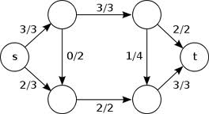
Theory: Flow Optimization

Slide 59
Max-Flow
Input:
undirected capacitated graph G=(V,E,c)
source vertex s, target vertex t
Output: maximum flow from s to t
2
c_{e}=2
1
1
max-flow = min-cut!
3
s
1
2
3
t
4
3

Slide 60
Multicommodity Flow
Input:
undirected capacitated graph G=(V,E,c)
demand matrix D={d_{ij}}
Output: flow f such that…
2
c_{e}=2
1
1
3
1
2
3
4
3

Slide 61
Multicommodity Flow
Maximum-multicommodity-flow: maximize the total amount of sent traffic
i.e., maximize Σ_{v}|f_{v}|, where |f_{v}| is the amount of traffic sent by vertex v
… while not exceeding capacities and demands
maximum-multicommodity-flow = ?
Minimize congestion: minimize the load on the most congested edge
i.e., minimize max_{e} f_{e}/c_{e}, where f_{e} is the flow along edge e
… while satisfying all demands, but possibly exceeding capacities
exceed the capacities?
Other objectives
fairness…

Slide 62
Multicommodity Flow Meets the Internet
Multicommodity flow computation optimizes
routes from sources to targets
how traffic is split between routes
Does IP routing optimize
routes from sources to targets?
how traffic is split between routes?

Slide 63
Optimizing (Static) Link Weights
2
w_{e}=3
1
1
3
2
1
5
4
3

Slide 64
Reminder: Shortest-Path Routing With “Static” Link Weights
Compute shortest paths to other routers based on link weights
link weights configured by network operator
... to determine the “next hop” to every other router
2
w_{e}=3
1
1
3
2
1
5
4
3

Slide 65
Why not Set Link Weights Dynamically?
Instantaneously increase the weight of heavily congested edges?
Weights inversely proportional to propagation delay?
2
w_{e}=3
1
1
3
2
3
1
5
4
3

Slide 66
Why not Set Link Weights Dynamically?
Instantaneously increase the weight of heavily congested edges?
Weights inversely proportional to propagation delay?
You know why…

Slide 67
Equal-Cost Multipath (ECMP)
Each router i computes shortest paths to each other router j based on the configured link weights
Let nxt_{ij} be the set of all of i’s next-hop nodes on its shortest-paths to j
Each router i splits traffic destined to router j evenly between all nodes in nxt_{ij}
hashing!
2
w_{e}=3
1
1
3
2
1
5
3
3

Slide 68
Illustration
0.25
0.25
f_{e}=0.5
incoming flow
1
f=1
0.25
0.25
0.5
0.5
0.5

Slide 69
How to Set Link Weights
Inversely proportional to link capacity?
Network-wide optimization?
2
w_{e}=3
1
1
3
2
1
5
4
3

Slide 70
Optimization Problem
Input:
undirected capacitated graph G=(V,E,c)
demand matrix D={d_{ij}}
Output: link weights such that ECMP flow is the optimal solution
with respect to specific objective function
2
c_{e}=2
1
1
3
1
2
3
4
3

Slide 71
Is the Optimal Solution Always Achievable with ECMP?
Consider congestion minimization
minimizing max_{e} f_{e}/c_{e}, where f_{e} is the flow along edge e
… while satisfying all demands, but possibly exceeding capacities
Are there always link weights such that the ECMP flow is optimal?
Are there always link weights that are “close to” the optimal solution?

Slide 72
Is the Optimal Solution Always Achievable with ECMP?
n = #vertices
c_{e}=n
n
n
n
S
…
1
1
1
1
1
1
OPT* ≤ 1
OPT_{ECMP} ≥ n/2
t

Slide 73
Link-Weight Optimization
Input:
undirected capacitated graph G=(V,E,c)
demand matrix D={d_{ij}}
Output: optimal link weights
such that the resulting ECMP flow is “closest” to specific objective function
2
c_{e}=2
1
1
3
1
2
3
4
3

Slide 74
Complexity of Link-Weight Optimization
NP-hard!
Even for simple objective functions
Theorem: Approximating the min-congestion multi-commodity flow within any constant factor is NP-hard.
even for a single source-target pair!

Slide 75
So, What Do Network Operators Do?
Heuristics: searching through weight settings
Clearly suboptimal, but shown effective in some real-life environments

Slide 76
A Closer Look at ECMP
How Does ECMP split traffic evenly between “next hops”?

Slide 77
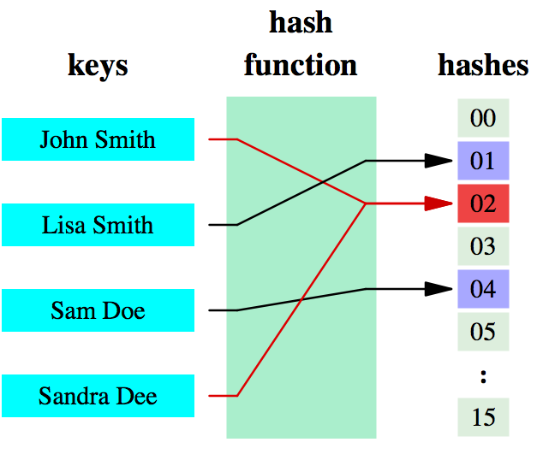
A Closer Look: ECMP Hashing
Hash function
Maps a large datum into a small datum, often a single integer that serves to index an associative array
In short: maps n-bit datum into k buckets (k << 2^{n})
Provides time- & space-saving data structure for lookup
Main goals:
Low “cost”
Deterministic
Uniformity (load balanced)

Slide 78
ECMP Hashing
Why not just round-robin packets?
Reordering
Different performance per path
Solution: Hash at a per-flow level

Slide 79
ECMP Hashing
Path-selection via hashing
# buckets = # outgoing links
Hash network information (source/dest IP addrs) to select outgoing link: preserves flow affinity

